Slide 1
Machine Learning
Introduction to the artistic science of all times
By: Faris Hassan
Farisology

Slide 2

Artificial Intelligence Major
Supervised Classification of TB using CXR
Data Analyst with Sedania Berhad - BIG DATA Dept.
Edu-tuber (Farisology), freelance trainer
Food lover, daddy of Owen (my cat)
I live – I love – I dream – I code

Slide 3
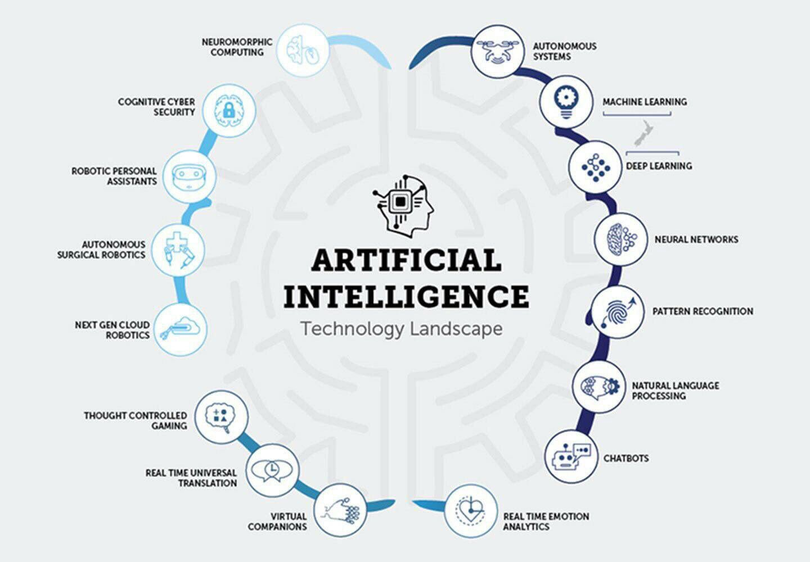

Slide 4
If else intelligence

Slide 5
Rise of Learning

Slide 6
What is Machine Learning?

Slide 7
Arthur 1959
is the subfield of computer science that gives computers the ability to learn without being explicitly programmed.

Slide 8
Tom Mitchel 1997
A computer program is said to learn from experience E with respect to some class of tasks T and performance measure P if its performance at tasks in T, as measured by P, improves with experience E.

Slide 9
Sequential Logic
Input
Processing
output

Slide 10
Machine Learning Logic
New Input
Output
Input/
examples
Output/
labels
Training
Model

Slide 11
Types of Learning problems
Supervised learning
Unsupervised learning
Reinforcement learning

Slide 12
Supervised Learning
Classification
Regression
Supervised Learning

Slide 13
Supervised Learning Diagram
Training
Model
New input
input
output
input
output
input
output
input
output
input
output
input
output
Output

Slide 14
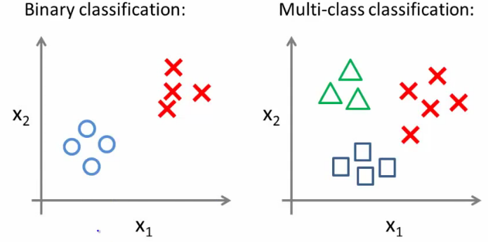

Slide 15
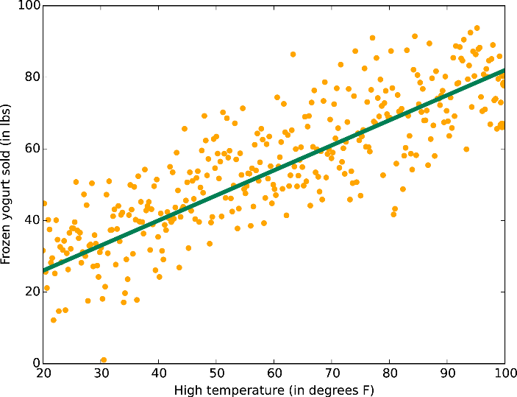

Slide 16
Unsupervised Learning
Dealing with data of unknown structure and we rely on the intelligence of the machine to explore the structure of the data to derive meaningful information independent from human guidance or reward function.

Slide 17
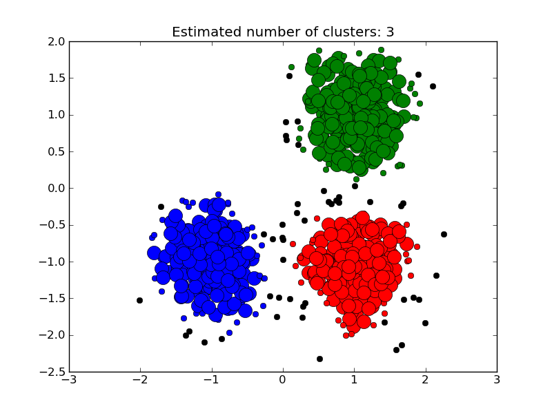

Slide 18
Types of Machine Learning Algorithms
ML Algorithms
Probabilistic
Linear
Tree Based
Evolutionary

Slide 19
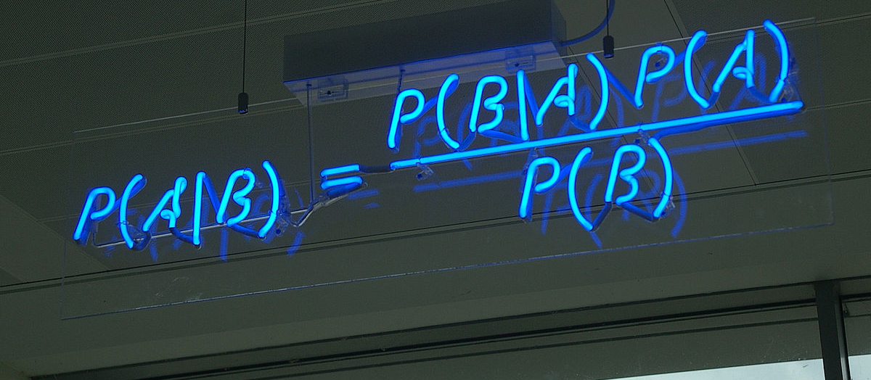
Probabilistic

Slide 20
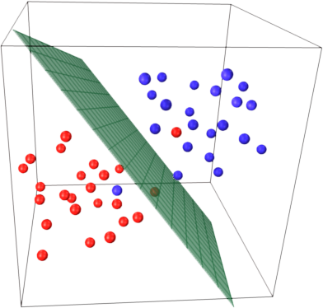
Linear Classification

Slide 21
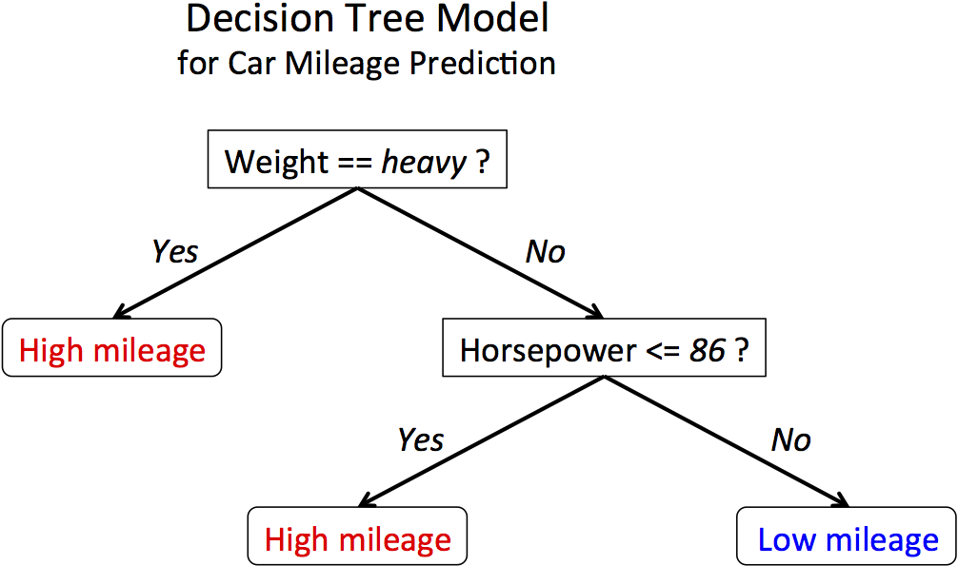
Tree Based

Slide 22
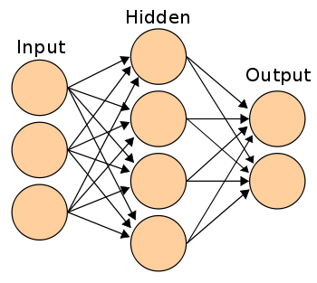
Artificial neural Network

Slide 23
How does Learning happen ?

Slide 24
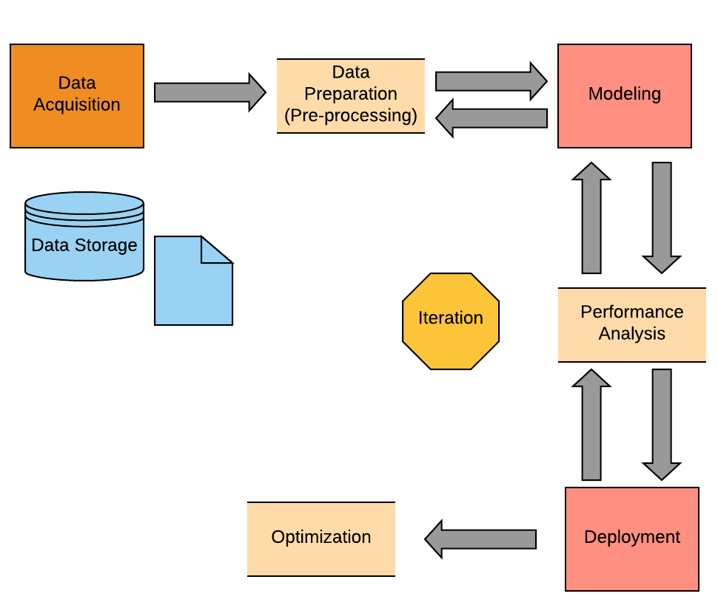
Machine Learning cycle

Slide 25
NO DATA NO DEAL

Slide 26
What are we trying to achieve ?
Good generalization
Over-fitting
Under-fitting
Better than random guess

Slide 27
Preprocessing
Segmentation
Handling missing values
Serialize categorical data
Standardize data
Features extraction

Slide 28


Get into your momentum and GROW

